Slide 1
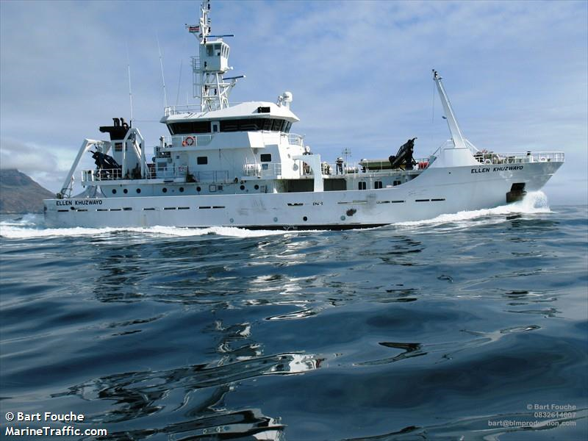
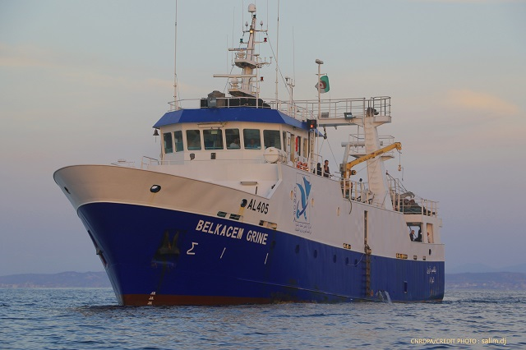
Capacity building for crew, instrument technicians and operators
Per W. Nieuwejaar
Director Research Vessel Department
Institute of Marine Research (IMR)
Bergen, Norway

Slide 2
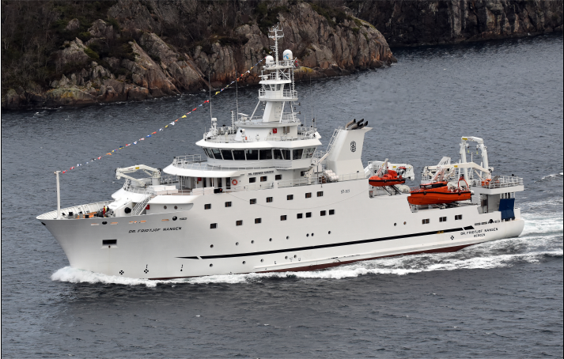
Background
Started with a recognition of the situation in Africa after 40 years of IMR operations in Africa, and the building of the third research vessel «Dr. Fridtjof Nansen», all purpose built for foreign aid work in Africa, Asia and Latin America, and the lack of operational «local» research vessels.
The obvious question was: How can we contribute to capacity building with regards to operational research vessels in countries we have supported on a regular basis for decades, and who have vessels and scientific equipment they do not seem to be able to utilize and support in a sustainable manner?
One answer to the question is: If you do not have skilled, professional crew, instrument technicians and vessel operators it is doomed to fail!

Slide 3
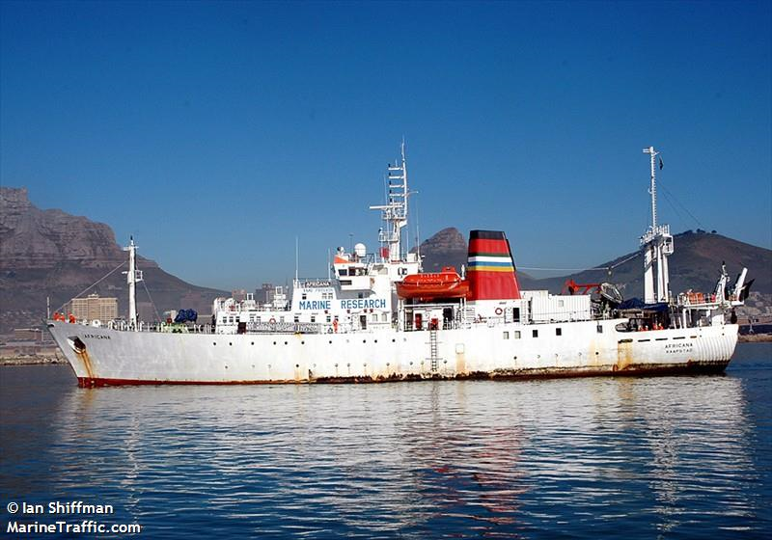
African RV fleet
IMR, with support from FAO in Rome, is currently «mapping» Africa with regards to research vessels that are «on the water» and more or less operational.
So far the list of RVs is not very long (21 RVs): - South Africa: SA Aghulas II (2012), Africana (1982), Ellen Khuzwayo (2007), Algoa (1975) - Namibia: Mirabilis (2012) - Angola: Baya Farta (2018), Pensador (2013) - Nigeria: Bayagbona (2014) - Guinea: General Lansana Conte (2002) - Senegal: Itaf Deme (2000) - Cape Verde: Islandia (1993) - Mauretania: Al-Awam (1996), Amrigue (1996) - Marocco: Charif Al Idrissi (1986), Amir Moulay Abdellah (2001), Al Hassani (1994) (New vessel to be delivered 2021 from Japan) - Tunisia: Hannibal (1998) - Algeria: Belkacem GRINE (2011) - Egypt: Salsabil (1989), Yarmouk (1989) - Kenya: Mtafiti (1977)

Slide 4
Support - The «easy ones»
Support for design and procurement of new vessels, modification/upgrade of existing vessels and solving specific functional and technical problems can be done through «pro bono» support from members of IRSO, ERVO, UNOLS etc. There are many examples of such support already and it is an integral part of many of these member organization’s activities already.
Training of crew Given that the persons to be trained have basic skills and some experience, it is a matter of setting aside one or more «scientific berths» for training purposes and let the RV crew train the trainees as a part of the regular activities on board, both ship routine work and scientific operations. This has to be training over an extended period of time to give useful results and must be done within a structured framework.

Slide 5
Support – The «challenging ones» - Training of instrument technicians
To become a marine instruments technician with all the necessary skills to calibrate, operate, maintain and repair marine scientific instruments and equipment on board a reasonably well equipped, modern RV require a solid basic technical education in computer science and/or electronics to begin with, and the next step is theoretical and practical training which can take months to complete, depending on the amount and frequency of realistic training and practice received due to availibility of training courses, RV cruises etc. This is a challenge also for «developed countries» since there are not many (any?) academic institutions offering a bachelors degree (or any other formal training for that matter) in marine scientific instrumentation to my knowledge. If there are, please let me know! Maybe it is time to establish some kind of «marine instrument technician academy»? It could be a number of theoretical courses of a few days or few weeks duration that are given in different parts of the world at different intervals, and/or virtual courses (Youtube, websites, e-learning etc) enabling students to take the courses on-line. Practical training can take place on board own RVs or on board other RVs if own country or institution do not have qualified instrument technicians already who can train the new ones.
Example: Norway’s Hydrographic Office will train IMR instrument technicians in seabed mapping on board «G.O. Sars» in November 2019

Slide 6
Support – The «challenging ones» - Training of RV operators
To operate RVs includes a set of basic functions that any ship operating company must have in place, such as crew management, maintenance systems and plans, safety management system, quality management system, budgeting and accounting etc. and be in compliance with all national and international legislation and rules, e.g. ISM, ISPS, MLC, MARPOL, SOLAS, PC. In addition comes the specialized tasks and «payload» connected to marine scientific activities at sea which is different from other types of trade (cargo ships, ferries, cruise liners etc) and in particular the need for staff who can manage the scientific instruments and the marine instrument technicians To recruit staff with the necessary skills and background from traditional «fleet management» and from traditional computer, software or electronics companies is usually not too difficult, but the challenge is to give them the skills and understanding of the application «RV management and operations» which is different from what they have been working with before.
Again, maybe it is time to establish some kind of «RV management academy»? It could be a number of theoretical courses of a few days or few weeks duration that are given in different parts of the world at different intervals and/or virtual courses (Youtube, websites, e-learning etc) enabling students to take the courses on-line.

Slide 7
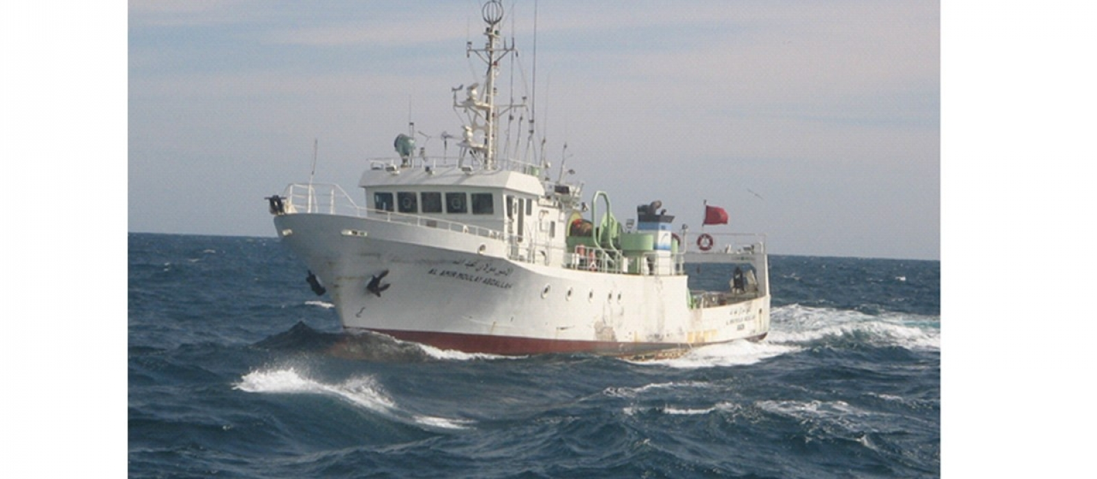
Support – The «challenging ones» - Establishing/improving shorebased vessel departments at RV operator institutions
In some cases in developing countries they procure (or receive as a «gift» from other nations) an RV without having an already established and functioning RV department, trained management staff, trained instrument technicians, and/or trained crew in place
This is definitely a challenge, and require support from national foreign aid agencies, or international organizations such as the UN through FAO, IOC, UNDP or other institutions.
At the same time it requires that «someone» with the relevant skills and experience are willing to allocate some of their own staff to take on the task of supporting the local staff to build up such an organization and follow up until it is selfsustained ,which will take at least a couple of years.

Slide 8
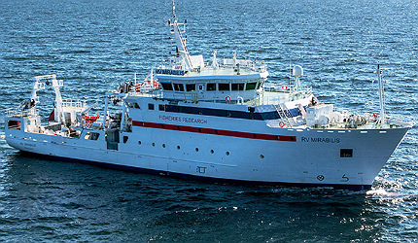
Conclusions
It is not much use in skilled scientists and technicians, RVs and scientific instruments and equipment if you do not have the necessary skilled staff on shore and on board, and the required organization with the necesary quality- and management systems in place!
But to build up and implement such skills and systems in «a vacuum» is almost impossible and therefore a framework is needed where such development can take place.
The best way to do it is to build on the competence and resources that already exists and find a way to «share the burden». Because no one can do everything, but everyone can do something!
So maybe we can have an IRSO and/or ERVO WG who could make proposals for some or all of these challenges?

Slide 9
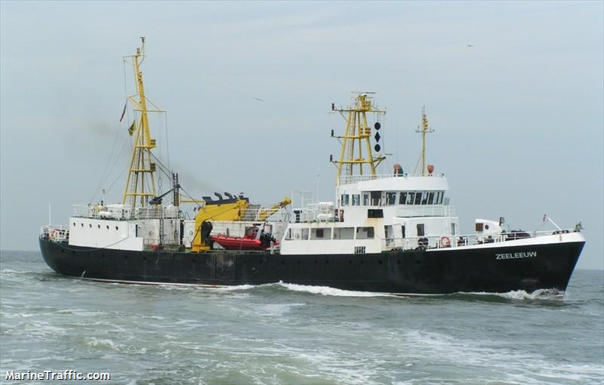
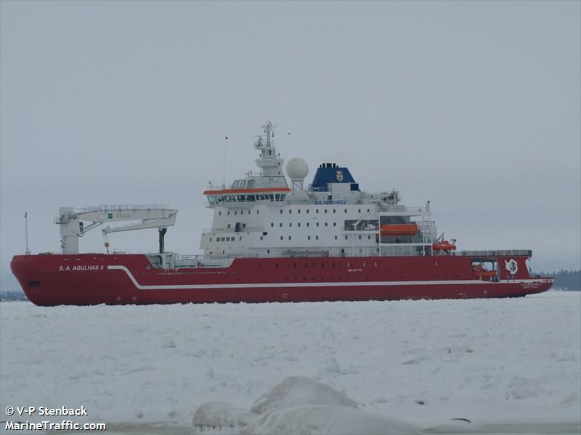
Norad and IMR project
The mapping of African RVs presented at the beginning is the first step towards a dedicated capacity building project for crew, Instrument technicians and operators.
When the map is ready we want to contact each African RV owner/operator to investigate if they are interested in such a project or not, and if so IMR will visit the institution and their vessel(s) and based on the findings see if we can set up a bilateral or multilateral plan for the necessary capacity building in each case.
We have also made initial contact with the Ocean Teacher Global Academy (OTGA) (www.oceanteacher.org) to see if we can develop training courses that can be managed by OTGA and lectures be given at their training hubs around the world, including their HQ in Oostende, Belgium.
These courses can also be available for European RV crew, instrument technicians and operators!
Plenty of work to be done, so if you are interested and willing to pitch in, let me know!

Slide 10
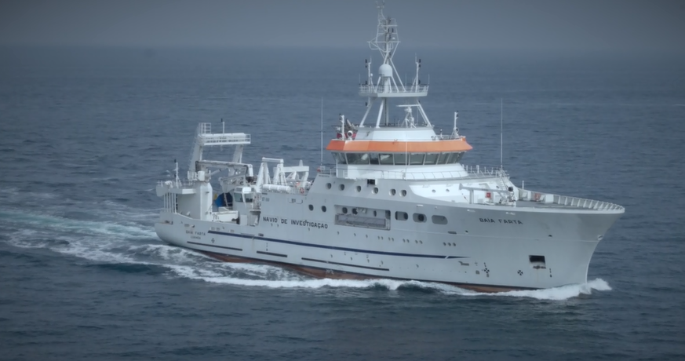
Questions?

